Slide 1
The Realtorial Project

Slide 2
Contributors
Team members:
Cael Thompson
Role: Augmented Reality SME/QA/Floater
thomp4cc@mail.uc.edu
Matt Heeter
Role: Team Lead/Machine Learning SME/Floater
heetermr@mail.uc.edu
Team advisor:
Giovani Abuaitah
abuaitgi@ucmail.uc.edu

Slide 3
Project Purpose and Goals
Goal: To create an application that will allow a user to create, through real-world inputs, tutorials that will be uploaded into the system that will then be displayed in the real-world to an end-user who will query for the tutorial.

Slide 4
Project Abstract
Realtorial is an augmented reality (AR)-based platform for creating and following tutorials. Realtorial will guide users through tasks via a head mounted display (HMD), providing guidance to users via an AR overlay that finds and highlights the object(s) needed for the task and provides cues for what to do with the objects(s). From the tutorial creation side, users will “record” themselves performing actions, making note to call out necessary objects and their manipulations. From there, tutorial-specific machine learning (ML) computer vision (CV) models will be trained. For tutorial followers, Realtorial will use the models from the creators to segment the same objects within their space. Object manipulations specified by the creators will also be shown, allowing tutorial followers to be guided through the task in their own, likely different, physical spaces.

Slide 5
User stories
User Story 1: I (the end-user) hold a rope in my hand. I ask the device holding the software, “How do I make this rope into a monkey knot”? The device then gives you a tutorial on how to do it.
User Story 2: I am the owner of a company who provides contracting services in the trades industry, and I want to more quickly spin up new employees on basic hand-tool use.
User Story 3: I am a digital content creator who focuses on tutorials, and I want to produce content for my audience that more accurately reflects the problem they are trying to solve.

Slide 6
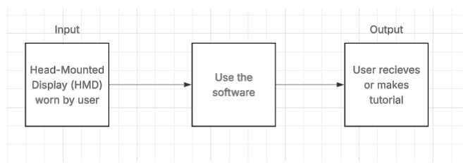
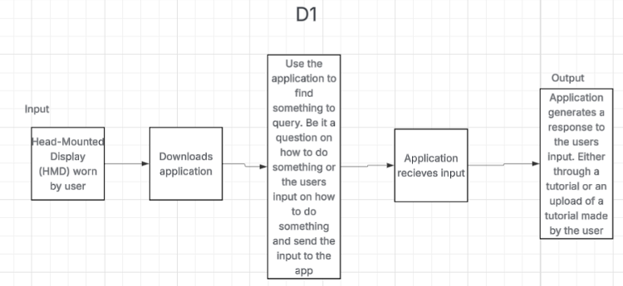
Design Diagrams (1 and 2)

Slide 7
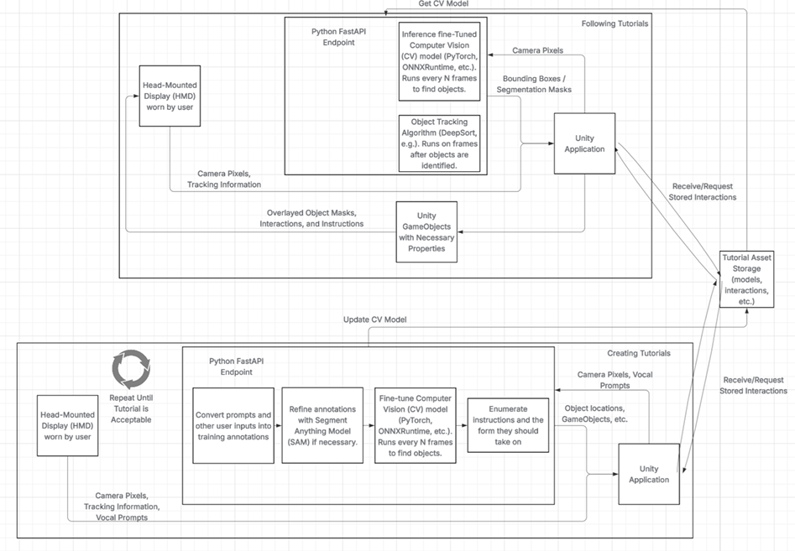
Design Diagrams (3)

Slide 8
Constraints
Economic
Freeware, device acquirement, revenue potential
Legal
User-designed tutorials, commercialization
Security
Data collection and safe-keeping
Social
Public service training

Slide 9
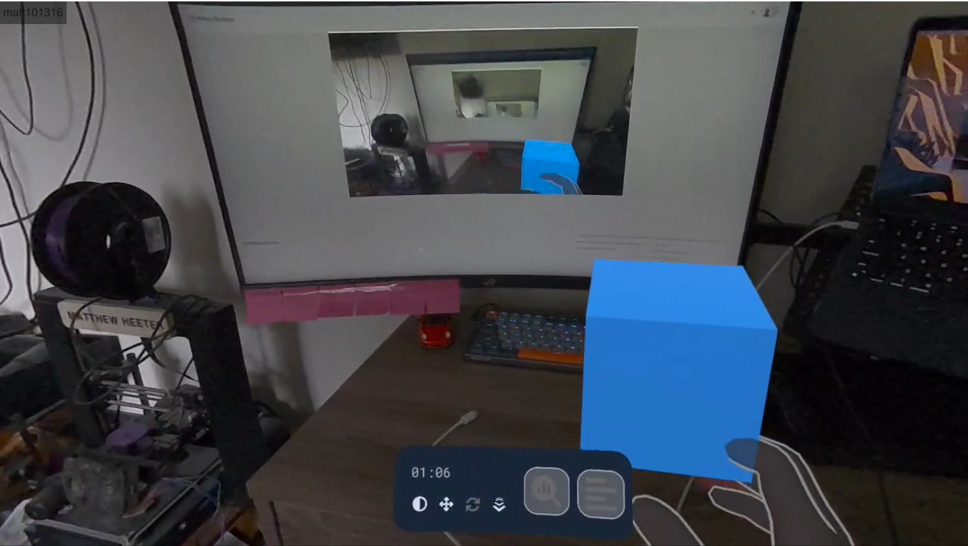
Project Progress
A GitHub repository that contains skeleton code for our Unity project and Python backend
Purchase of Meta's Quest3S headset
A Unity setup that enables building AR experiences that can be deployed to the device

Slide 10
Expected Accomplishments for the end of this term
A repository created for our project
A better understanding of the software/tools we will be using (Unity, Python, etc.)
Several hours of initial setup and development to prepare for working on the product

Slide 11
Division of Work
1. Establish unity project and setup with version control and team environment (GitHub repository, Unity Version Control, etc.)
a. Cael Thompson
2. Download dependencies (AR/XR toolkits, AI, etc.)
a. Cael Thompson / Matt Heeter
3. Create Python development environment for backend development
a. Matt Heeter / Cael Thompson
4. Draft Python FastAPI that encapsulates training and inference code
a. Matt Heeter
5. Develop UI by creating dynamic objects that represent user actions
a. Cael Thompson
6. Research computer vision (CV) methodologies to discover what is optimal for our use case
a. Matt Heeter

Slide 12
Division of Work Continued
7. Experiment with different CV models for object detection (Dino, YOLO, etc.) to find one that works with given hardware constraints
a. Matt Heeter
8. Implement chosen model
a. Matt Heeter
9. Implementation of calls to FastAPI by Unity project scripts
a. Cael Thompson
10. Creation of interaction overlays in Unity that are displayed by the user
a. Cael Thompson
11. Integration testing to ensure individual components work together
a. Matt Heeter / Cael Thompson
12. Debugging of various systems
a. Matt Heeter / Cael Thompson

Slide 13
Division of Work Continued
13. Deployment of application onto Meta Quest 3S head-mounted display
a. Matt Heeter
14. Presentation and demonstration of our final project
a. Matt Heeter / Cael Thompson

Slide 14
CEAS Demo Expectations
A few fully-operational tutorials created with Realtorial that participants can take part in
Some props that Realtorial instructs people to manipulate to accomplish some goals
A monitor displaying what the user sees for any audience to observe

